Slide 1
Implement a people detection system capable of detecting and tracking individuals in images or video streams using an open-source dataset

Slide 2
Overview of Models
Techniques Used: The model leverages YOLOv8n for lightweight object detection and Kalman Filters for dynamic object tracking.
Dataset Overview: The dataset is divided into training, validation, and testing sets to ensure robust model evaluation.
Evaluation Metrics: The model’s performance is evaluated using precision, recall, mean IoU, FPS, and average latency.

Slide 3
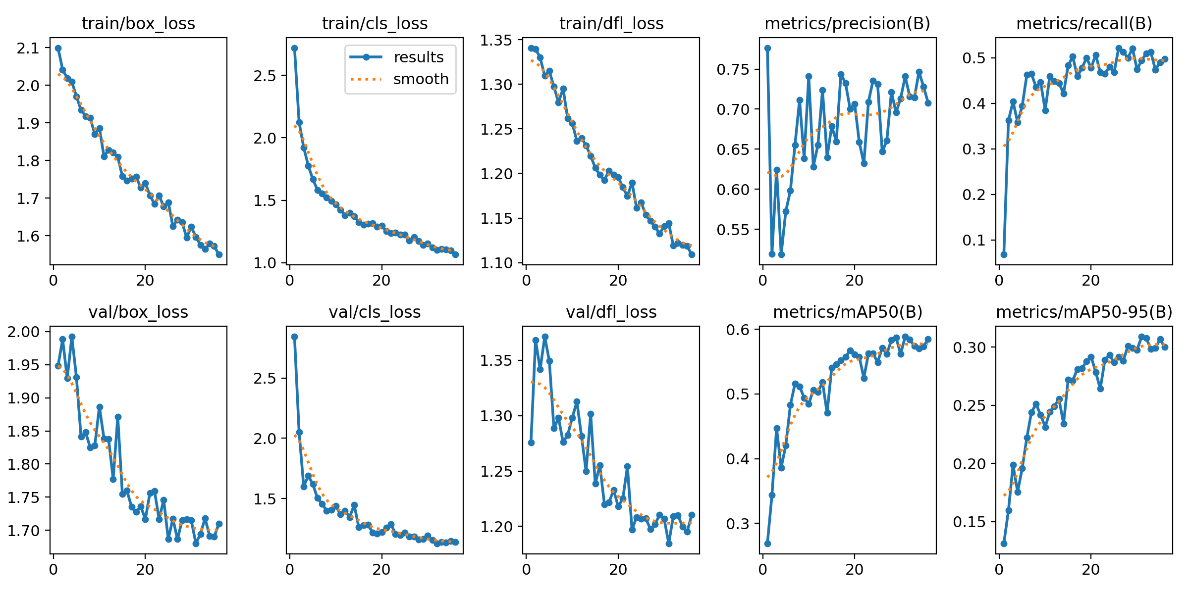
Module result

Slide 4
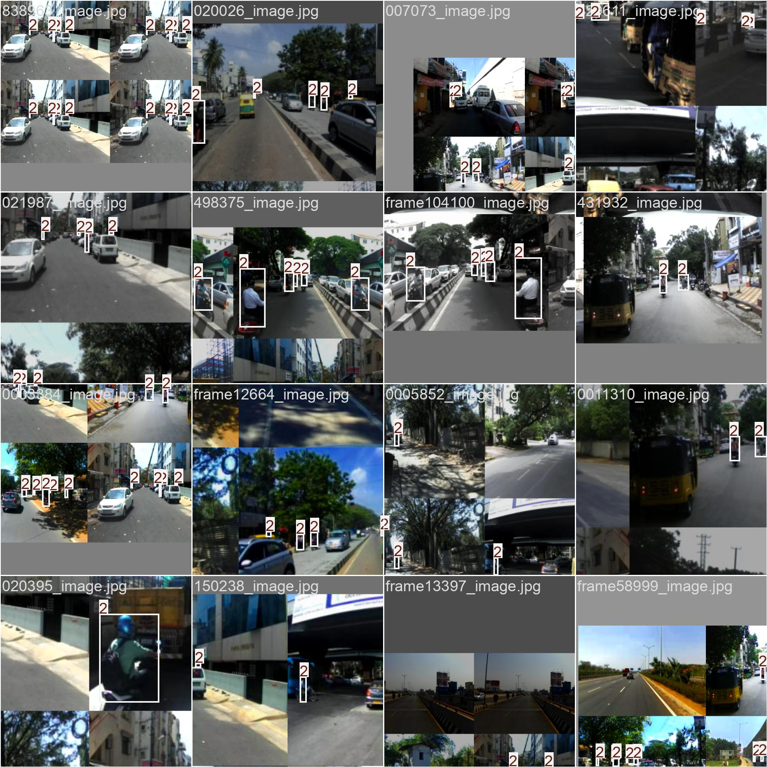
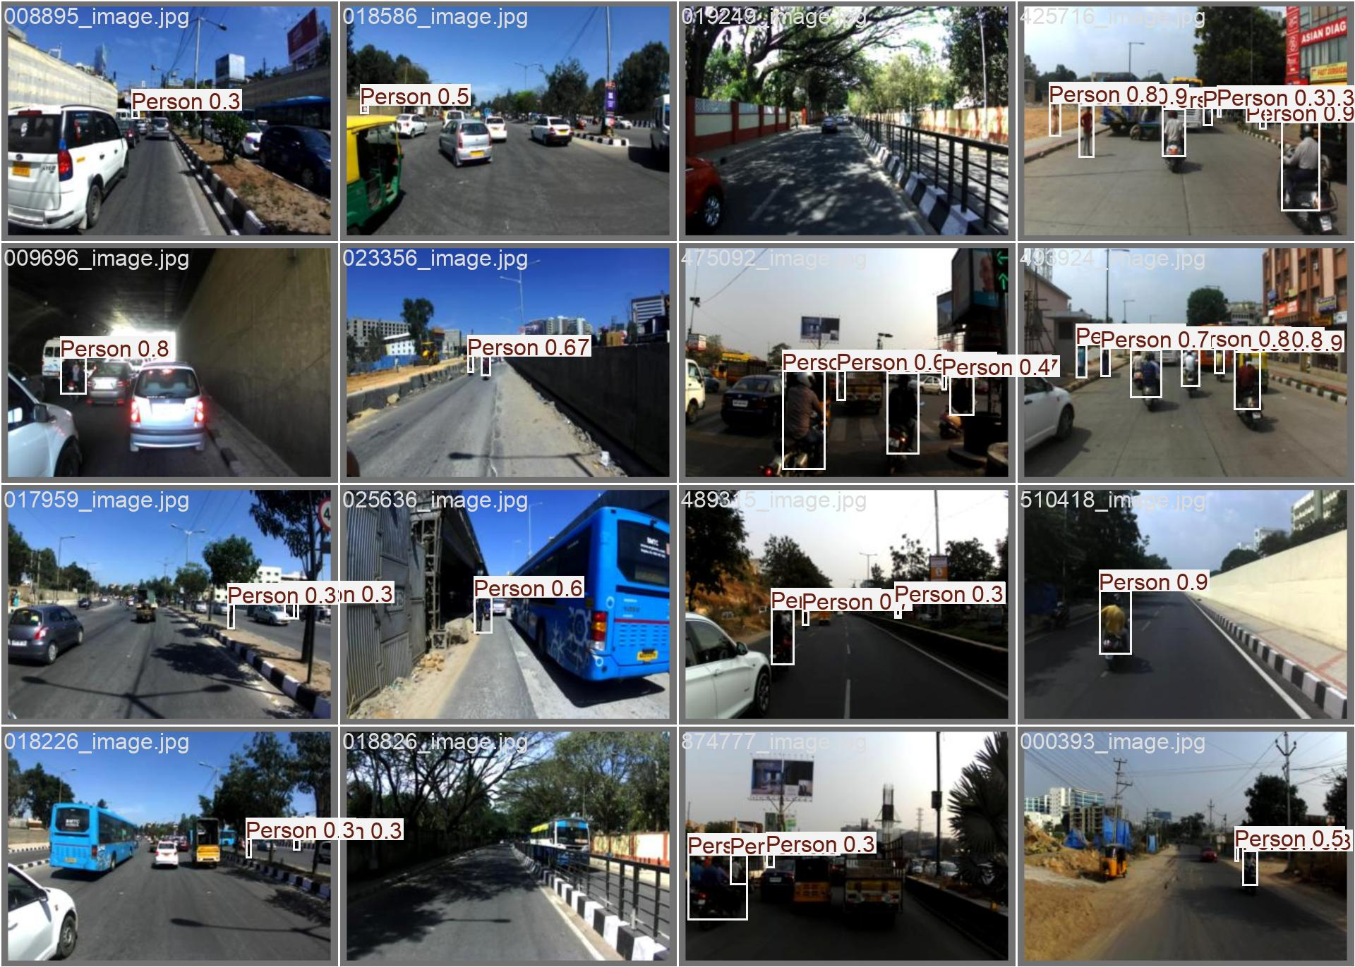
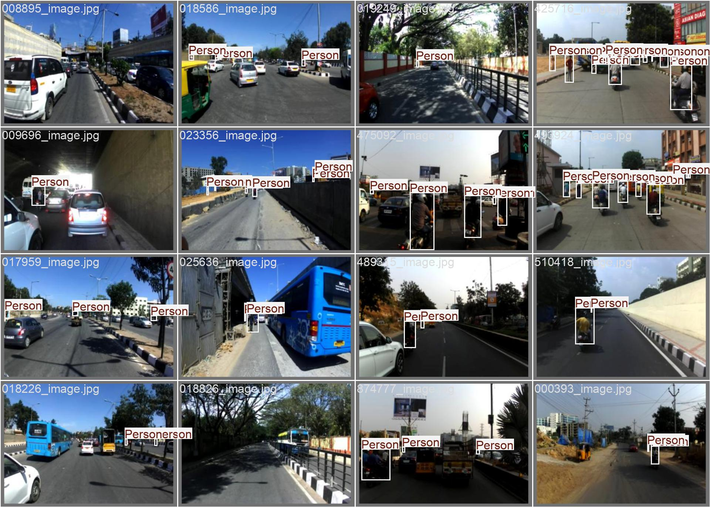
Batch 0 Result
train_batch0
val_batch0_labels
val_batch0_pred

Slide 5
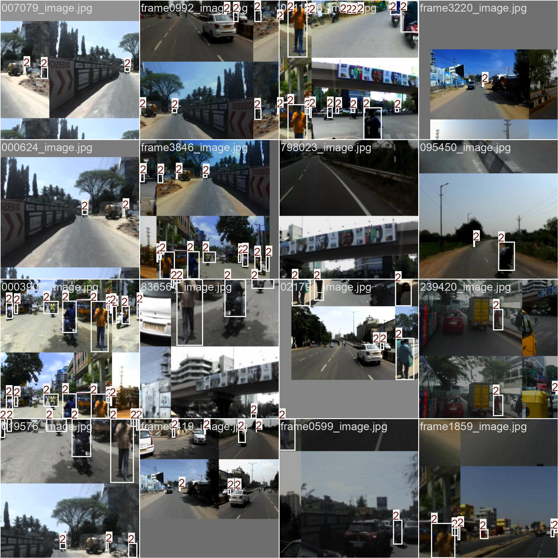
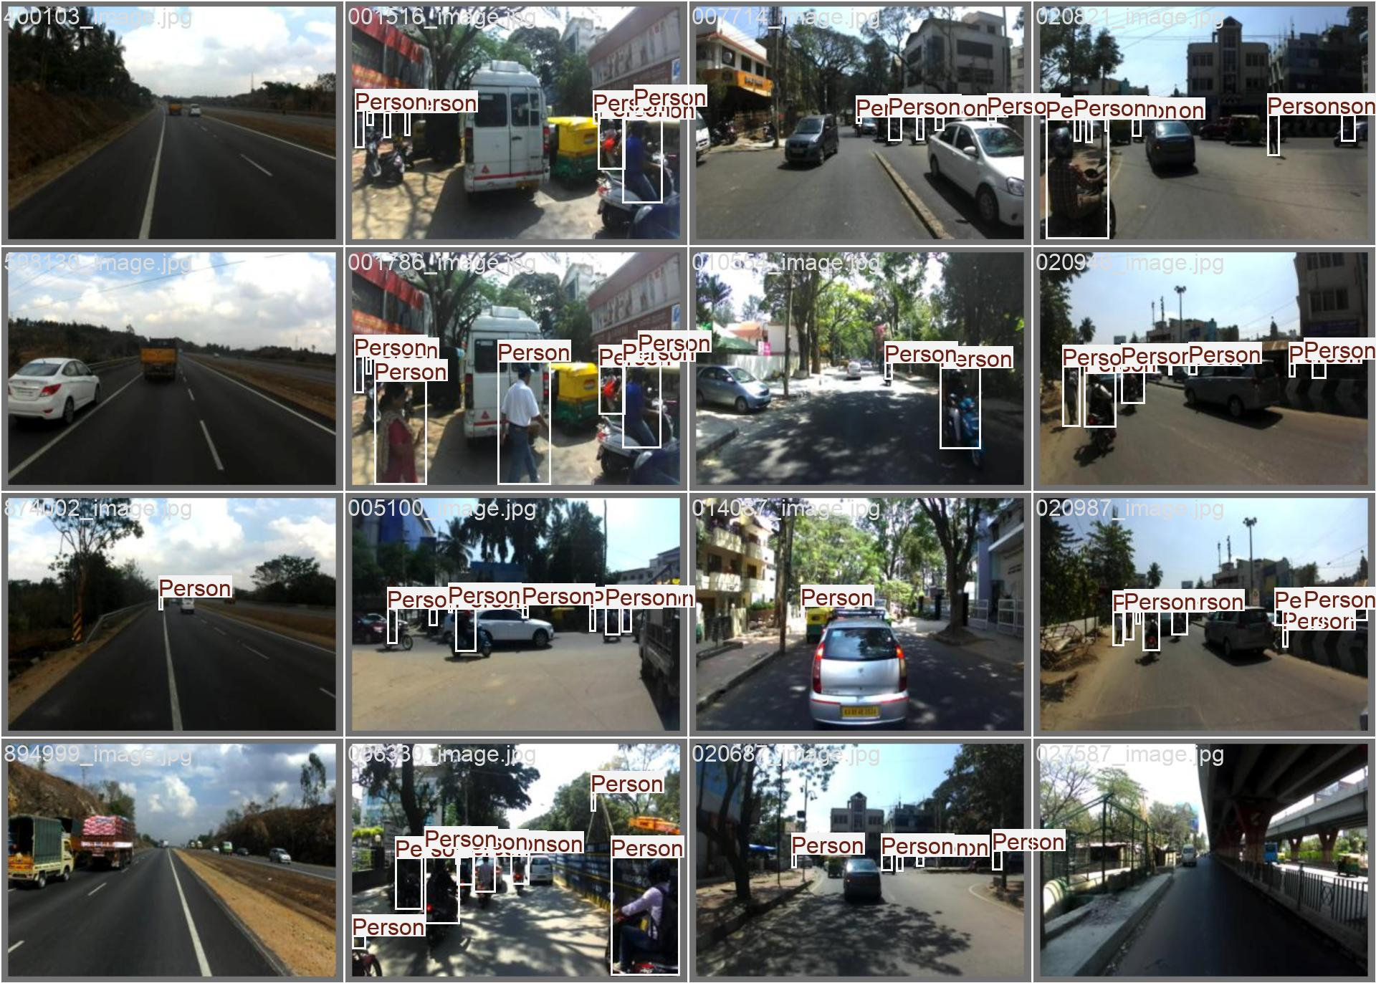
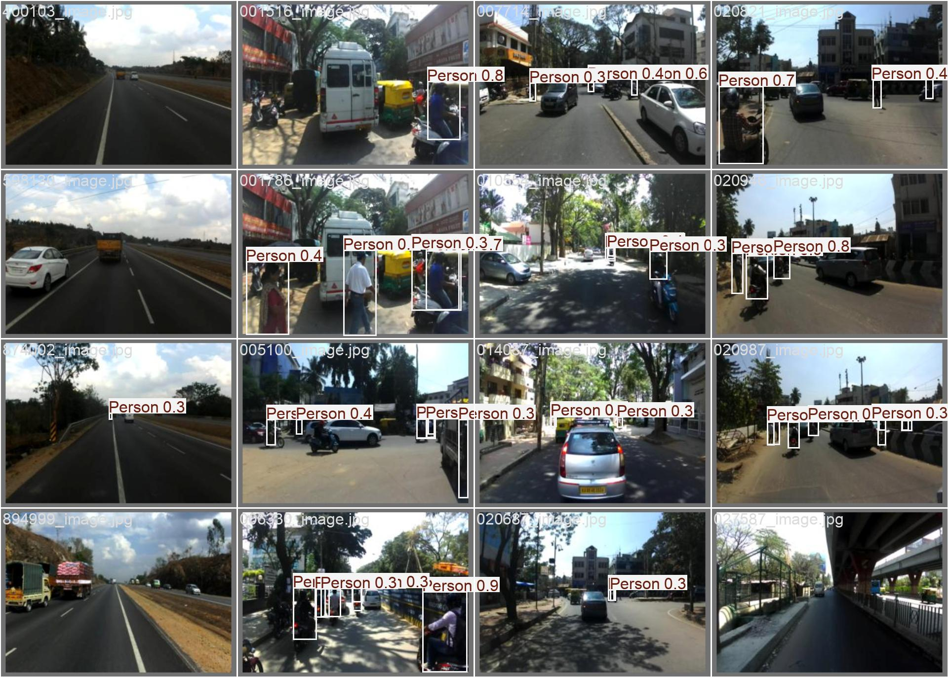
Batch 1 Result
train_batch1
val_batch1_labels
val_batch1_pred

Slide 6
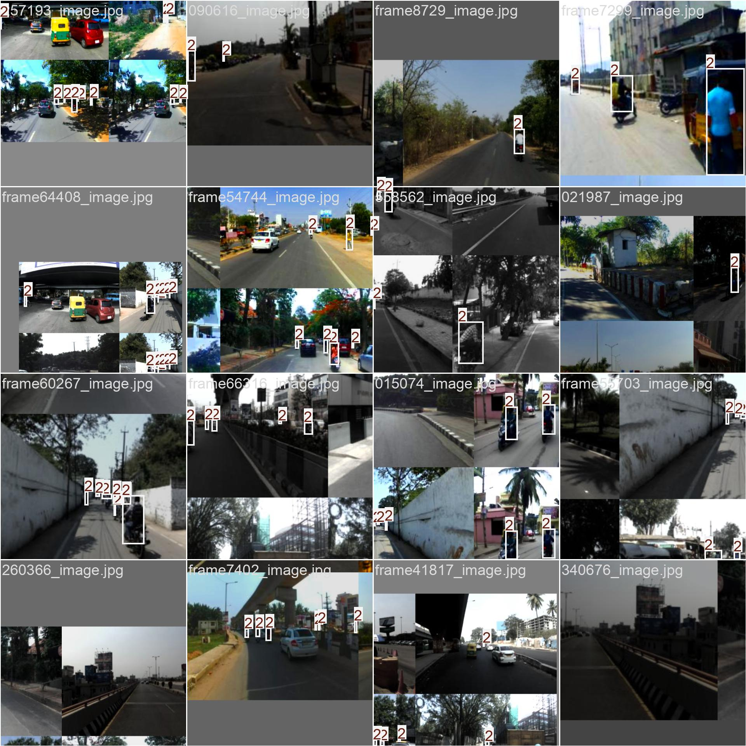
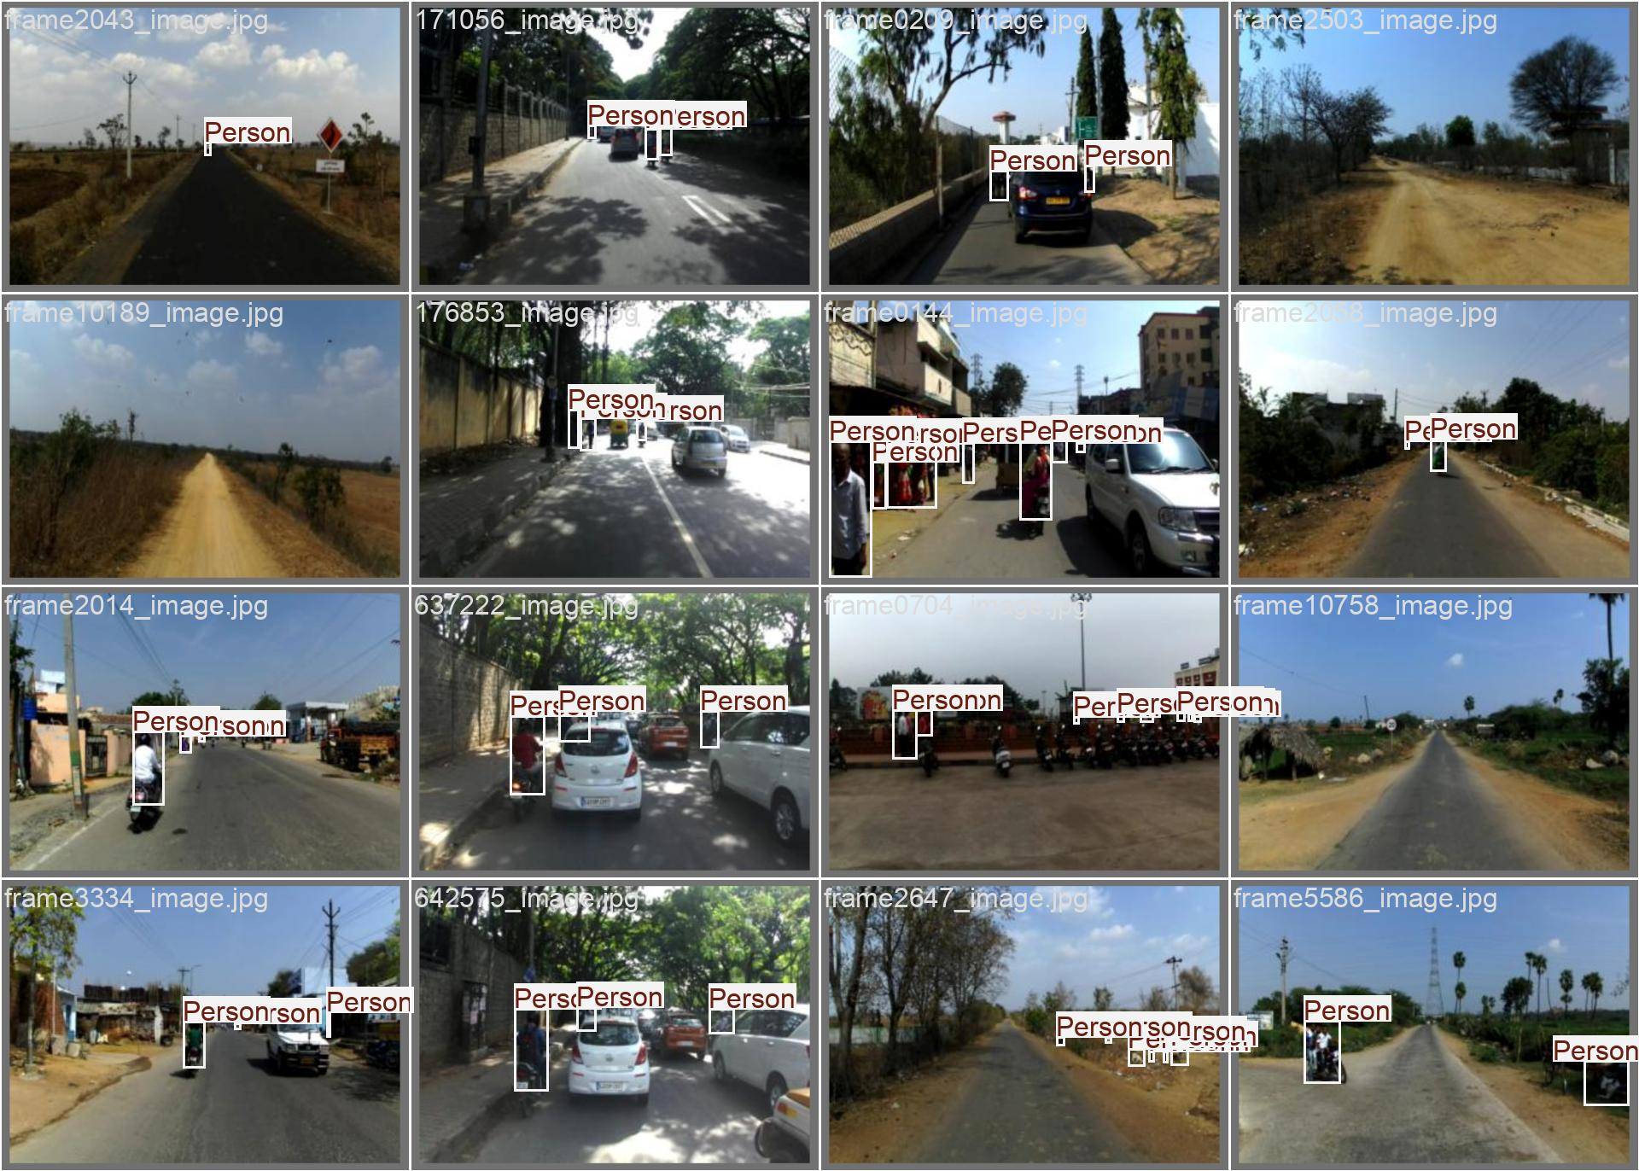
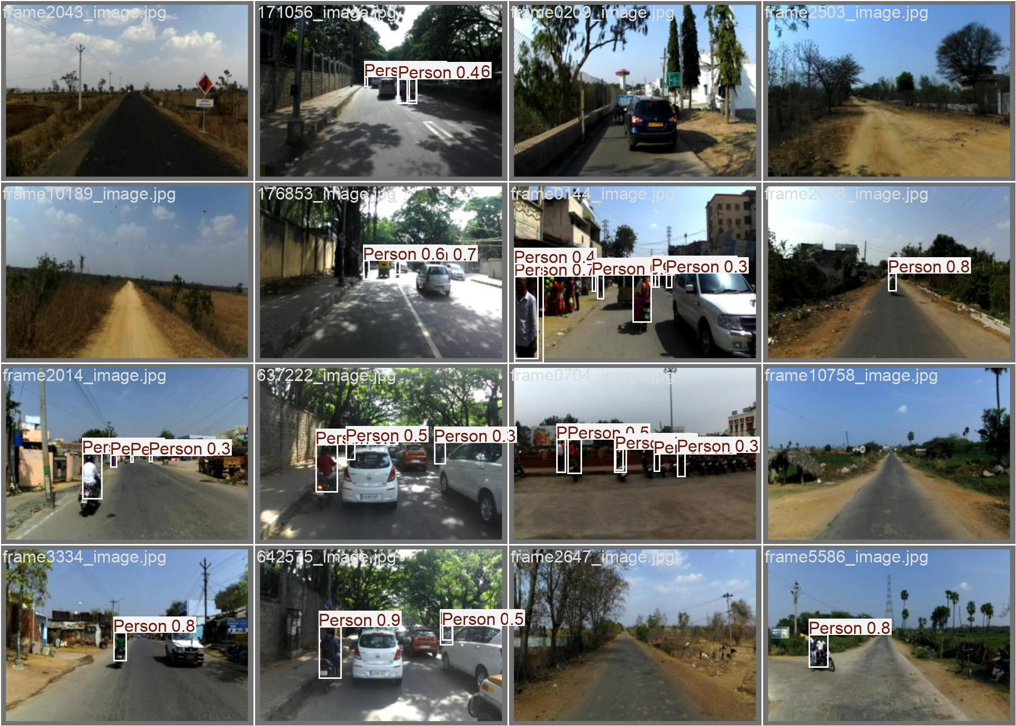
Batch 2 Result
train_batch2
val_batch2_labels
val_batch2_pred

Slide 7
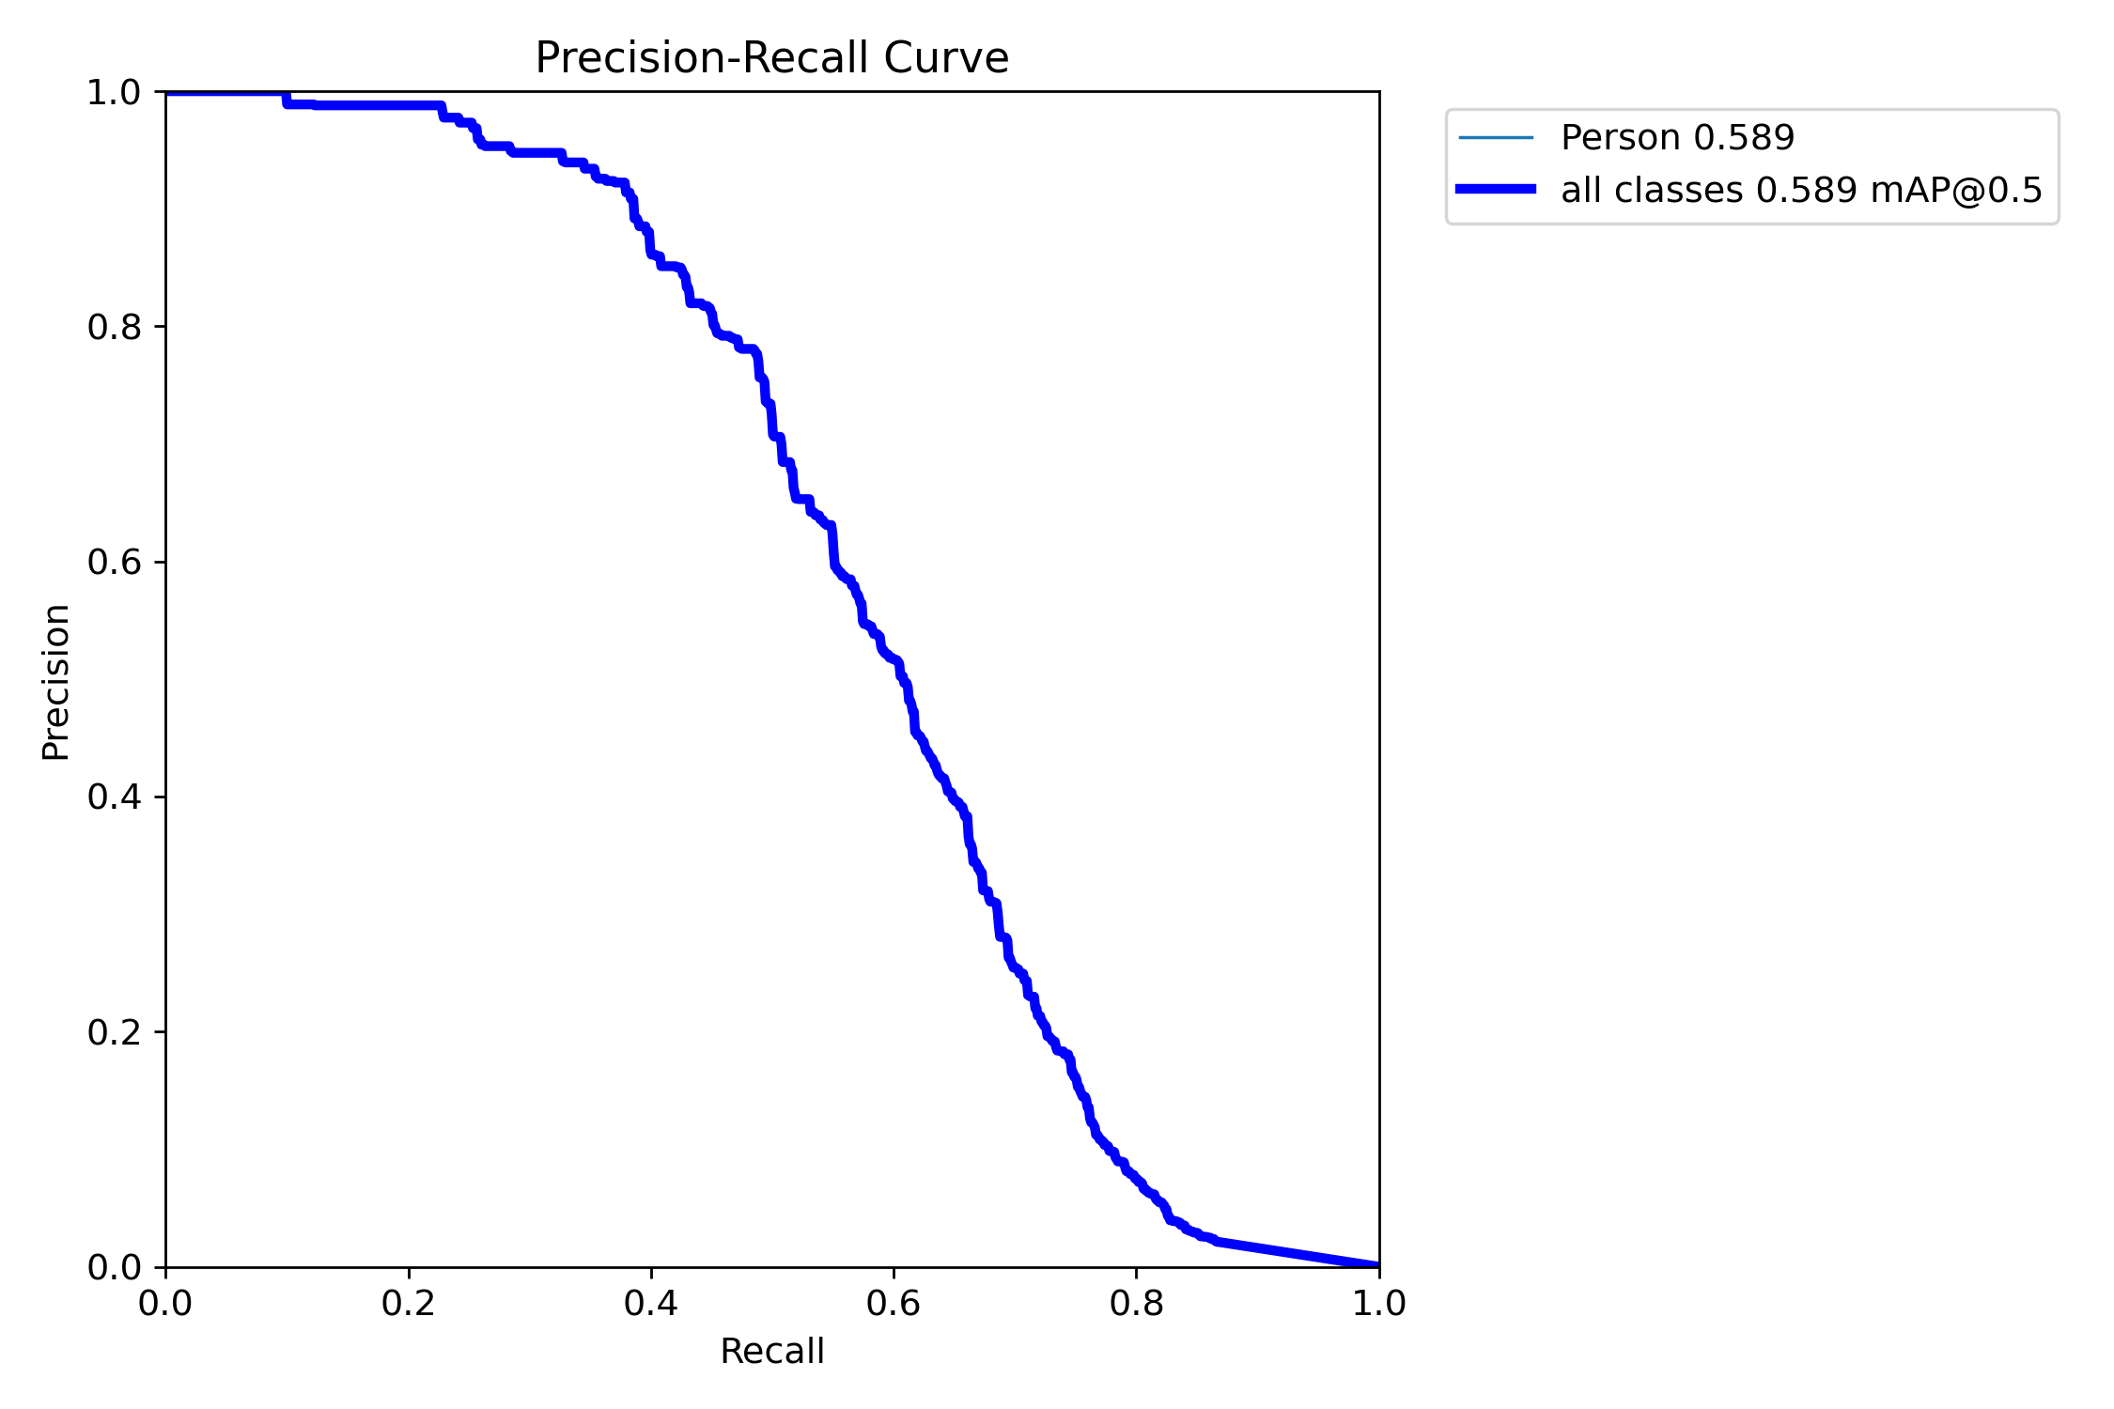
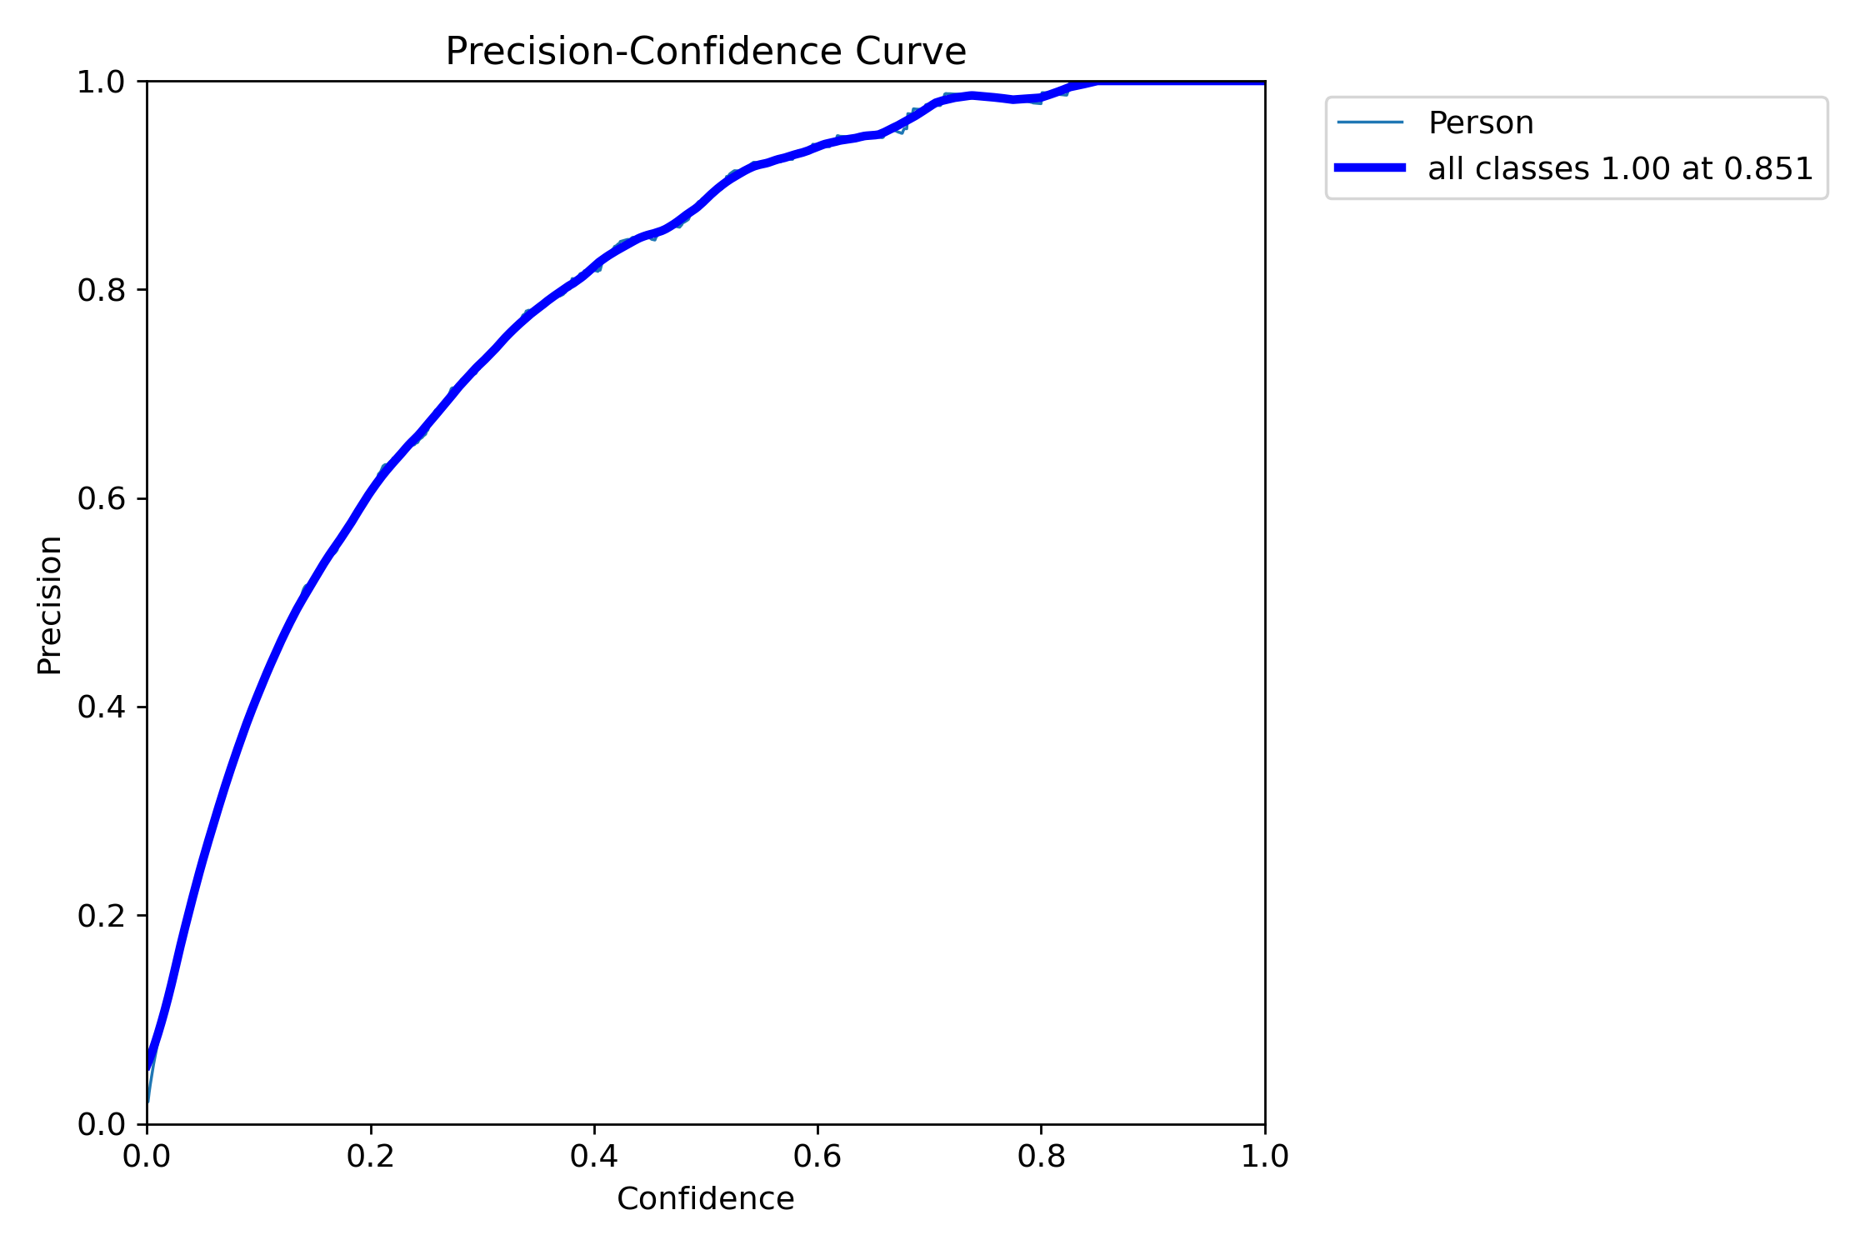
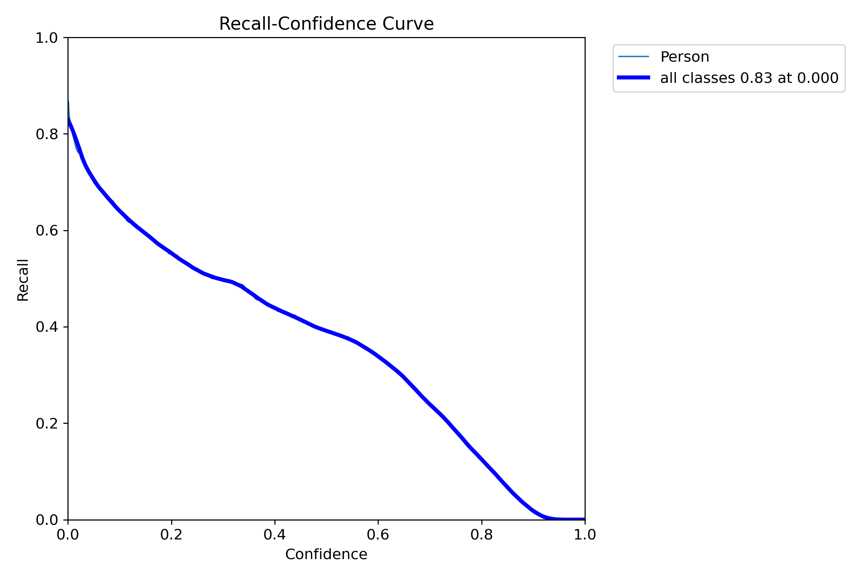
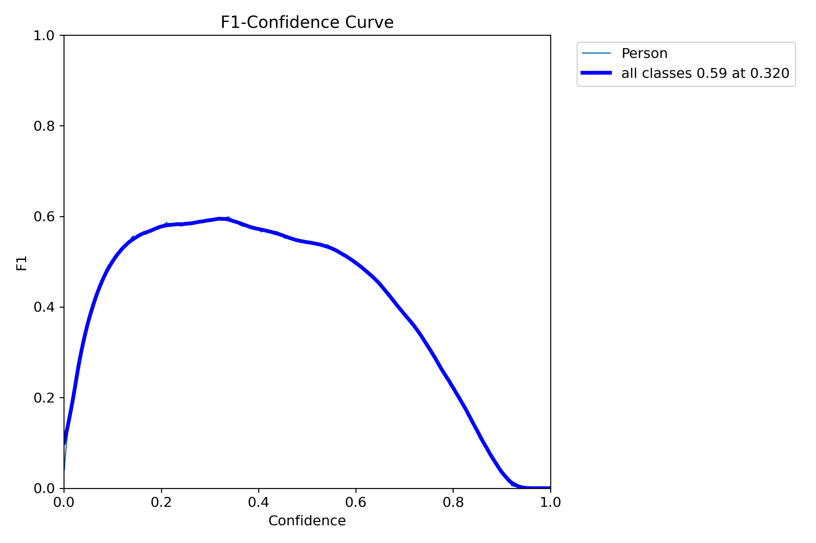
Metrics curves

